Slide 1
Promises and Error Handling

Slide 2

Errors in JavaScript
Introduction
Error Handling
Using try and catch
finally
Developer Defined Errors
Creating a Promise
Settling a Promise
Promises and Async/Await

Slide 3
Errors in JavaScript

Slide 4
Errors in JavaScript
let car = newCar;
console.log('continuing...');

Slide 5
Error Handling Using try and catch

Slide 6
try and catch
try {
let car = newCar;
}
catch(error) { console.log('error: ', error);
}
console.log('continuing...');

Slide 7
finally

Slide 8
try, catch, finally
try {
let car = newCar;
}
catch(error) { console.log('error: ', error);
}
finally {
console.log('this always executes');
}

Slide 9
Developer Defined Errors

Slide 10
throw
try {
// code here...
throw new Error('my custom error');
}
catch(error) { console.log('error: ', error);
}
finally {
console.log('this always executes');
}

Slide 11
Creating a Promise

Slide 12
Create a Promise
let promise = new Promise(
function(resolve, reject) { setTimeout(resolve, 100, 'someValue');
}
);

Slide 13
Settling a Promise

Slide 14
Settling a Promise
let promise = new Promise( function(resolve, reject) {
setTimeout(resolve, 100, 'someValue');
}
);
promise.then(
value => console.log('fulfilled: ' + value), error => console.log('rejected: ' + error)
);

Slide 15
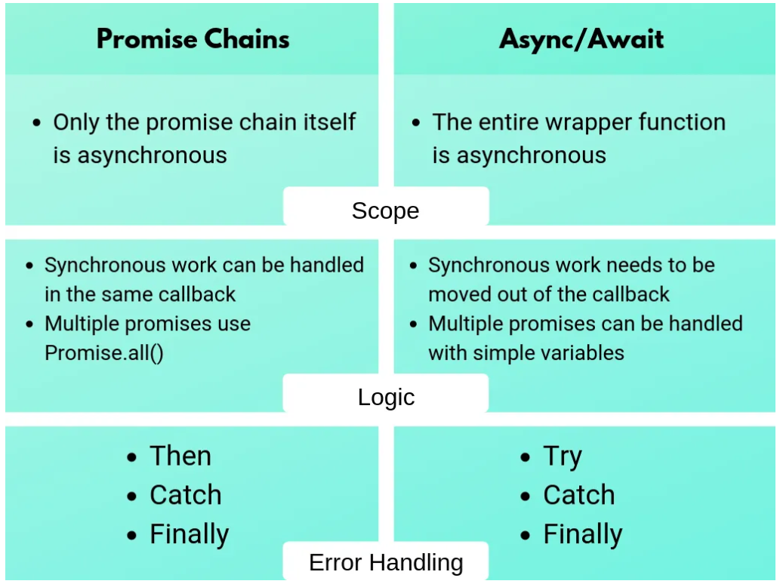
Promises and Async/Await

Slide 16
Errors in JavaScript
Summary
Stop execution?
Error Handling Using try and catch
catch executes on an exception
finally
always executes
Developer Defined Errors
throw

Slide 17
Summary
Creating a Promise
function(resolve, reject)
Settling a Promise
then( fullfilledFn, rejectedFn )
Promises and Async/Await

